Slide 1
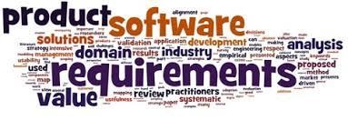
Software Requirement Engineering
Establishing the business requirements
Week # 6

Slide 2
Content
• Establishing the business requirements
• Defining business requirements
• Vision and scope document
• Scope representation techniques

Slide 4
Defining Business Requirements
• “Business requirements” refers to a set of information that, in the aggregate, describes a need that leads to one or more projects to deliver a solution and the desired ultimate business outcomes.
• Business opportunities, business objectives, success metrics, and a vision statement make up the business requirements.
• The business requirements provide a reference for making decisions about proposed requirement changes and enhancements.

Slide 5
Identifying desired business benefits
• The business requirements set the context for, and enable the measurement of, the benefits the business hopes to achieve from undertaking a project.
• Organizations should not initiate any project without a clear understanding of the value it will add to the business.
• Set measurable targets with business objectives, and then define success metrics that allow you to measure whether you are on track to meet those objectives.

Slide 7
Product vision and project scope
• Two core elements of the business requirements are the vision and the scope.
• The product vision describes the ultimate product that will achieve the business objectives.
• This product could serve as the complete solution for the business requirements or as just a portion of the solution.

Slide 8
Product vision and project scope
• Two core elements of the business requirements are the vision and the scope.
• The product vision describes the ultimate product that will achieve the business objectives.
• This product could serve as the complete solution for the business requirements or as just a portion of the solution.
• The vision describes what the product is about and what it ultimately could become.

Slide 9
Product vision and project scope
• It provides the context for making decisions throughout the product’s life, and it aligns all stakeholders in a common direction.
• The project scope identifies what portion of the ultimate product vision the current project or development iteration will address.
• The statement of scope draws the boundary between what’s in and what’s out for this project.

Slide 10
Conflicting business requirements

Slide 12
Vision and scope document
• The vision and scope document collects the business requirements into a single deliverable that sets the stage for the subsequent development work.
• Organizations that build commercial software often create a market (or marketing) requirements document (MRD).
• An MRD might go into more detail about the target market segments and the issues that pertain to commercial success.

Slide 13
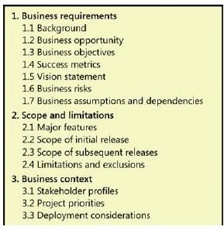
Vision and scope document
• Figure 5-3 suggests a template for a vision and scope document;
• Some elements of the vision and scope document might be reusable from project to project, such as business objectives, business risks, and stakeholder profiles.
Figure 5-3 Template for a vision and scope document.

Slide 14
Vision and scope document
1.1 Background
1.2 Business opportunity
1.3 Business objectives

Slide 16
1.4 Success metrics

Slide 17
1.5 Vision statement

Slide 18
1.5 Vision statement

Slide 19
Vision and scope document
• Figure 5-3 suggests a template for a vision and scope document;

Slide 20
3. Business context
3.1 Stakeholder profiles
Each stakeholder profile should include the following information:
■ The major value or benefit that the stakeholder will receive from the product. Stakeholder value could be defined in terms of:
• Improved productivity.
• Reduced rework and waste.
• Cost savings.
• Streamlined business processes.
• Automation of previously manual tasks.
• Ability to perform entirely new tasks.
• Compliance with pertinent standards or regulations.
• Improved usability compared to current products.
■ Their likely attitudes toward the product.
■ Major features and characteristics of interest.
■ Any known constraints that must be accommodated.

Slide 21
Project priorities
Each dimension fits in one of the following three categories on any given project:
■ Constraint A limiting factor within which the project manager must operate
■ Driver A significant success objective with limited flexibility for adjustment
■ Degree of freedom A factor that the project manager has some latitude to adjust and balance against the other dimensions

Slide 22
Project priorities
The project manager’s challenge is to adjust the degrees of freedom to achieve the project’s success drivers within the limits imposed by the constraints. Suppose marketing suddenly demands that you release the product one month earlier than scheduled. How do you respond? Do you:
■ Defer certain requirements to a later release?
■ Shorten the planned system test cycle?
■ Demand overtime from your staff or hire contractors to accelerate development?
■ Shift resources from other projects to help out?

Slide 24
Scope representation techniques
• Context diagrams, ecosystem maps, feature trees, and event lists are the most common ways to represent scope visually.
• Identifying affected business processes also can help define the scope boundary.
• Use case diagrams can depict the scope boundary between use cases and actors.

Slide 25
Context diagrams
• The scope description establishes the boundary and connections between the system you’re developing.
• The context diagram visually illustrates this boundary.
• It identifies external entities (also called terminators) outside the system that interface to it in some way, as well as data, control, and material flows between the terminators and the system.

Slide 26
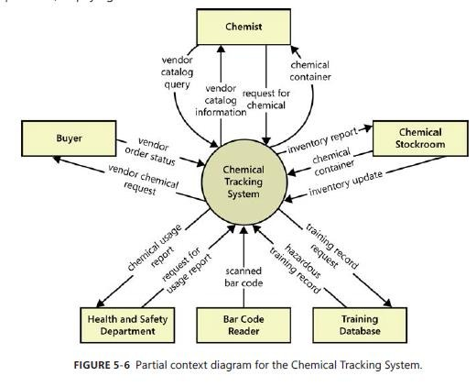

Slide 27
Ecosystem map
• An ecosystem map shows all of the systems related to the system of interest that interact with one another and the nature of those interactions.
• An ecosystem map represents scope by showing all the systems that interconnect and that therefore might need to be modified to accommodate your new system.
• Ecosystem maps differ from context diagrams in that they show other systems that have a relationship with the system you’re working on, including those without direct interfaces.

Slide 28
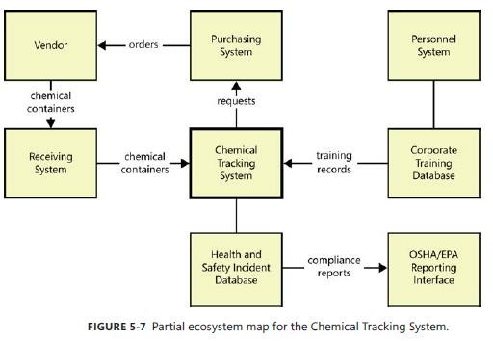

Slide 29
Feature tree
• A feature tree is a visual depiction of the product’s features organized in logical groups, hierarchically subdividing each feature into further levels of detail.
• The feature tree provides a concise view of all of the features planned for a project, making it an ideal model to show to executives who want a quick glance at the project scope.
• A feature tree can show up to three levels of features, commonly called level 1 (L1), level 2 (L2), and level 3 (L3).
• L2 features are sub-features of L1 features, and L3 features are sub- features of L2 features.

Slide 30
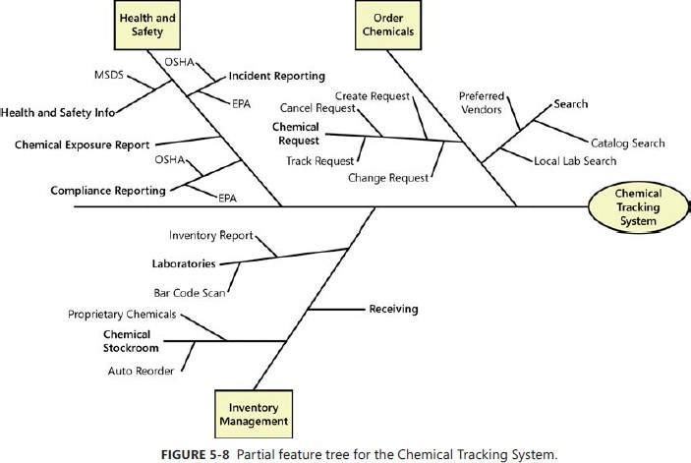

Slide 31
Event list
• An event list identifies external events that could trigger behavior in the system.
• The event list depicts the scope boundary for the system by naming possible business events triggered by users, time-triggered (temporal) events, or signal events received from external components, such as hardware devices.
• The event list only names the events; the functional requirements that describe how the system responds to the events would be detailed in the SRS by using event-response tables.

Slide 32
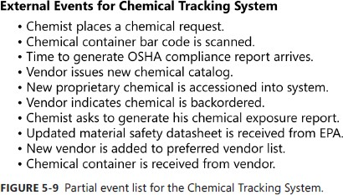

Slide 33
Summary
• Establishing the business requirements
• Defining business requirements
• Vision and scope document
• Scope representation techniques

